Slide 1

OWASP TOP10
Check (mate) to the vulnerabilities
Some reflections about OWASP TOP 10 and chess game

Slide 2
Who am I?
Sebastian Revuelta
Security Engineer at Thales Alenia Space.
More than 15 years working in software security (and quality)
Application Security: DevSecOps | SAST | SCA | Pentesting
Blog: securingsoftware.blog
Chess player in my childhood
sebastianrevuelta@gmail.com
https://www.linkedin.com/in/sebasrevuelta/

Slide 3
Agenda
Threats in software application security
OWASP top 10
Definition
Example
Solutions
Chess comparisons
OWASP in the software life cycle

Slide 4
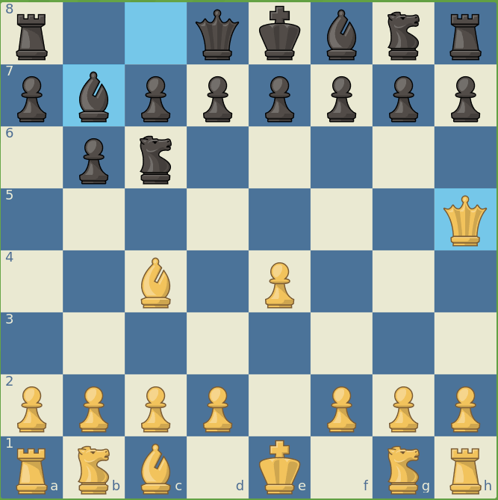
Threats in chess
“A threat is simply a move that attacks one of your pieces to get some advantage if you don’t find an accurate defense”
Sheperd check mate

Slide 5

Threats in chess
"The threat is stronger than the execution“ Aaron Nimzowitch (Latvia 1886, chess grandmaster).
We need to keep the tension and do our best all the time to avoid vulnerable points in our system.
Every move should be done to avoid risky points.

Slide 6
Threats in software
Can we guess/predict threats for our app?
As in a chess game we need to predict the next move of the other player (hacker?). A move that can affect our software systems.
Threat modeling is like brainstorming of possible moves a hacker can do against our system.
There are different methodologies to follow: STRIDE, CAPEC, Attack Tree, OWASP TOP 10 …

Slide 7
Injection
Broken Authentication
Insecure Deserialization
Using components with vulnerabilities
Insufficient Logging
Cross Site Scripting
Security Misconfiguration
Sensitive data exposure
Broken Access Control
XML External Entity
OWASP TOP 10

Slide 8
Injection
Broken Authentication
Insecure Deserialization
Using components with vulnerabilities
Insufficient Logging
Cross Site Scripting
Security Misconfiguration
Sensitive data exposure
Broken Access Control
XML External Entity
OWASP TOP 10

Slide 9
Injection - Definition
Injection happens when untrusted data is sent to an interpreter as part of a command or query. The attacker’s hostile data can trick the interpreter into executing unintended commands or accessing data without proper authorization.
If the injection affects our database then we talk about SQL Injection.
If the injection affects our logs then we talk about Log Injection.
If the injection executes some commands of our system then we talk about Command Injection.
And there are more injection issues as LDAP injection, XPATH injection.
Front End
untrusted data
Business Logic
bbdd

Slide 10
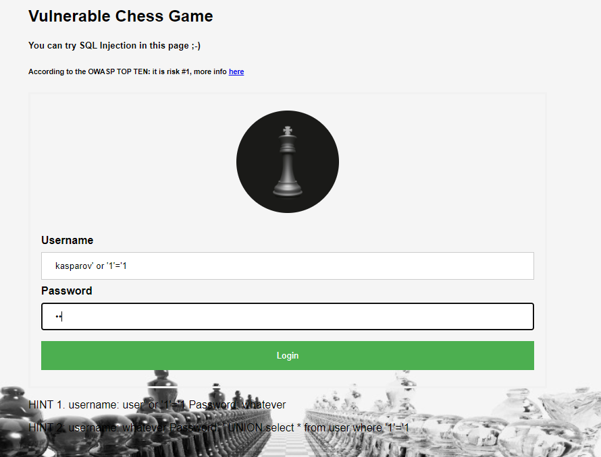
Injection - demo

Slide 11
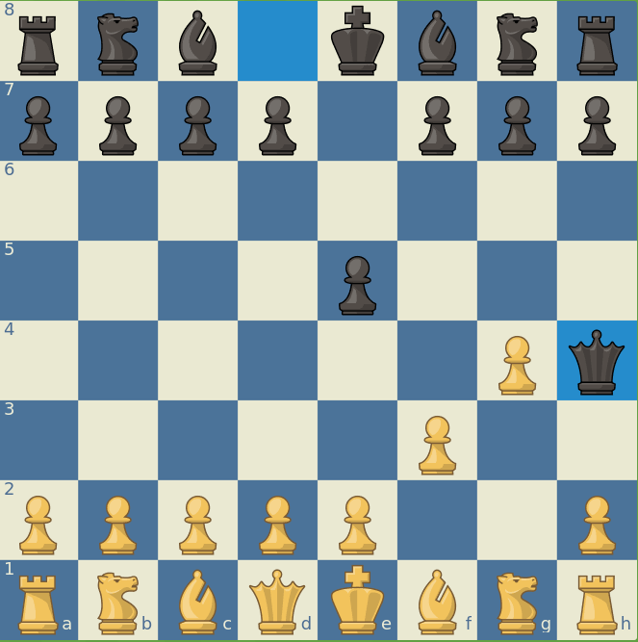
Injection
Chess
comparison
Bad defense, no one can stop the attack.
It is the fastest check mate of the history.
backend

Slide 12
Injection: solutions
Validate each input. “Don’t trust in the end user”
Whitelist
Regular expression
String length
Data type
Use modern frameworks
Use prepared statements (SQL Injection)
Use stored procedure (SQL Injection)
https://cheatsheetseries.owasp.org/cheatsheets/SQL_Injection_Prevention_Cheat_Sheet.html

Slide 13
Injection
Broken Authentication
Insecure Deserialization
Using components with vulnerabilities
Insufficient Logging
Cross Site Scripting
Security Misconfiguration
Sensitive data exposure
Broken Access Control
XML External Entity
OWASP TOP 10

Slide 14

Broken authentication - Definition
Application functions related to authentications and session management are often implemented incorrectly, allowing attackers to compromise passwords, keys, or session tokens, or to exploit other implementations flaws to asume other users’ identities temporarily or permanently.

Slide 15
Broken authentication - Demo
Force brute attack, testing 10000 most common passwords
Front End
Business Logic
bbdd

Slide 16
Broken authentication - solutions
Multi factor authentication (MFA)
Remove any default credentials
Implement weak-passwords check
Implement password policies (NIST 800-63B).
Limit or increasingly delay failed login attempts.
Session IDs should not be in the URL.

Slide 17
Injection
Broken Authentication
Insecure Deserialization
Using components with vulnerabilities
Insufficient Logging
Cross Site Scripting
Security Misconfiguration
Sensitive data exposure
Broken Access Control
XML External Entity
OWASP TOP 10

Slide 18
Sensitive data exposure - definition
Many web applications and APIs do not properly protect sensitive data, such as financial, healthcare, and PII. Attackers may steal or modifiy such weakly protected data to conduct credit card fraud, identity theft, or other crimes. Sensitive data may be compromised without extra protection, such as encryption at rest or in transit, and requires special precautions when exchanged with the browser.
Front End
End user
password in clear
Business Logic
bbdd
Attacker

Slide 19

Sensitive
data
exposure
Chess
comparison
Exposed through open columns
Sensitive data

Slide 20
Sensitive data exposure - Solutions
Classify data processed, stored or processed by an application. Identify which data is sensitive according to laws, regulatory requirements, or business need.
Apply controls as per the classification
Don’t store sensitive data unnecesarily.
Make sure to encrypt all sensitive data at rest.
Ensure up-to-date and strong standard algorithms, protocols and keys are in place.
Disable caching for response that contain sensitive data.

Slide 21
Injection
Broken Authentication
Insecure Deserialization
Using components with vulnerabilities
Insufficient Logging
Cross Site Scripting
Security Misconfiguration
Sensitive data exposure
Broken Access Control
XML External Entity
OWASP TOP 10

Slide 22
XML External Entity - definition
XML External Entities (XXE) Many older or poorly configured XML processors evaluate external entity references within XML documents. External entities can be used to disclose internal files using the URI handler, internal file shares, internal port scanning, remote code execution, and denial of Service attacks.
Attacker
Front End
Denial of Service
Access internal files
xml payload
Business Logic
bbdd

Slide 23
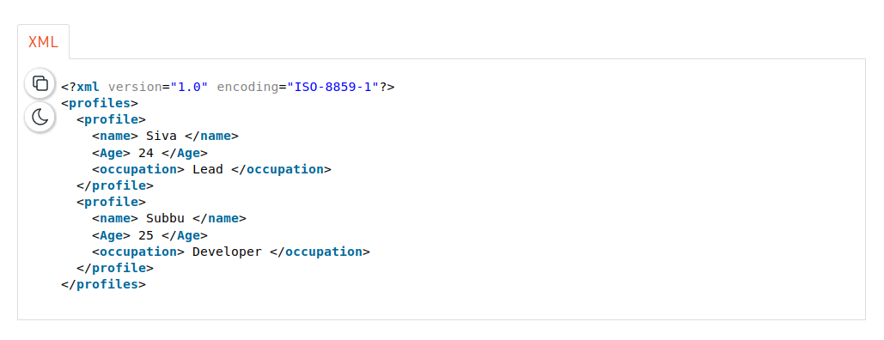
XML External Entity – example 1
Access internal files

Slide 24
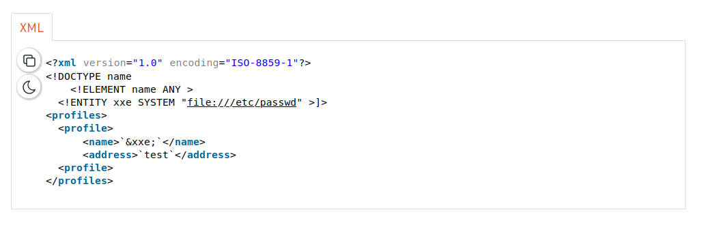
XML External Entity – example 1
Access internal files

Slide 25
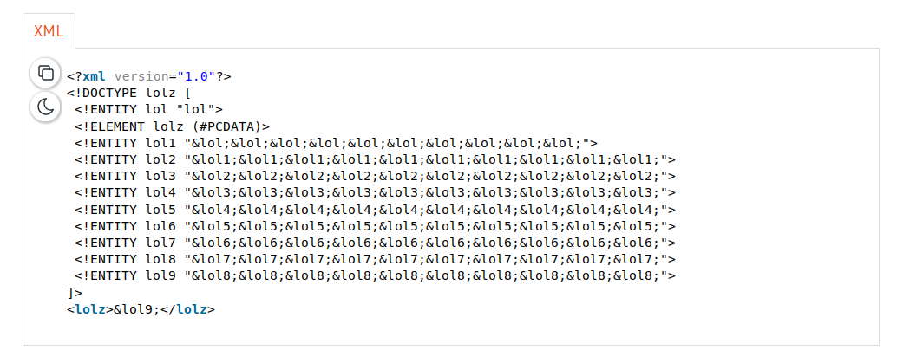
XML External Entity – example 2
Denial of service

Slide 26
XML External Entity – solutions
Whenever possible, use less complex data formats such as JSON.
Patch or upgrade all XML processors and libraries in use by application or on the underlying operating systems.
Disable XML external entity and DTD processing in all XML parsers in the application.
Verify that XML or XSL file upload functionality validates incoming XML using XSD validation or similar.

Slide 27
Injection
Broken Authentication
Insecure Deserialization
Using components with vulnerabilities
Insufficient Logging
Cross Site Scripting
Security Misconfiguration
Sensitive data exposure
Broken Access Control
XML External Entity
OWASP TOP 10

Slide 28
Broken Access Control - definition
Restrictions on what authenticated users are allowed to do are often not properly enforced. Attackers can exploit these flaws to access unauthorized functionality and/or data, such as access other users’ accounts, view sensitive files, modify other users’ data, change access rights.
Admin
features
Normal user
Front End
Business Logic
bbdd

Slide 29
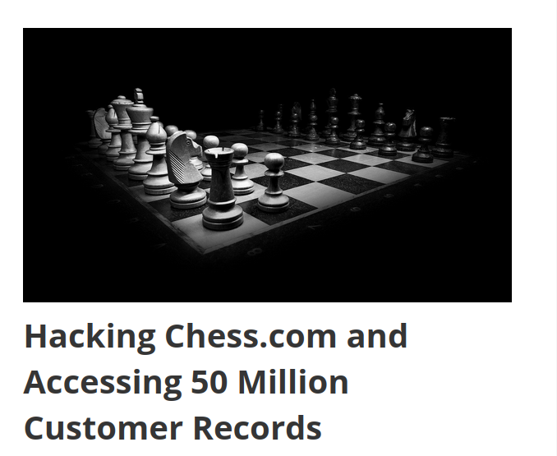
Broken Access Control - example

Slide 30
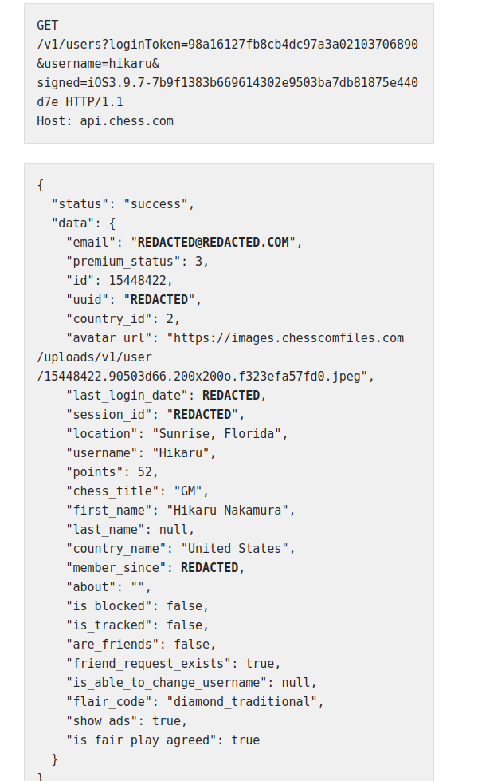
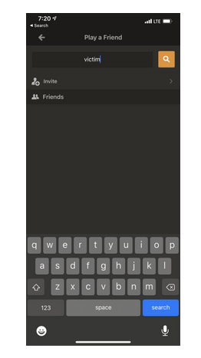
Broken Access Control - definition

Slide 31
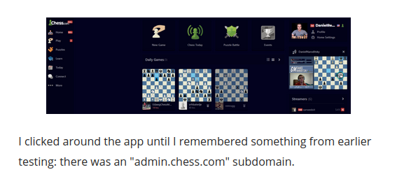
Broken Access Control - definition

Slide 32
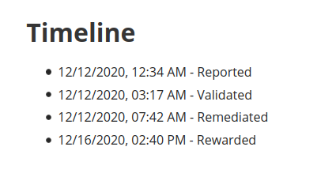
Broken Access Control - definition

Slide 33
Broken Access Control - solution
Implement access control mechanism once and re-use them
Disable web server directory listing and ensure file metadata and backup files are not present within web roots.
Log access control failures, alerts admins when appropriate.
Rate limit API and controller access to minimize the harm from automated attack tooling.
JWT tokens should be invalidated on the server after logout.

Slide 34
Injection
Broken Authentication
Insecure Deserialization
Using components with vulnerabilities
Insufficient Logging
Cross Site Scripting
Security Misconfiguration
Sensitive data exposure
Broken Access Control
XML External Entity
OWASP TOP 10

Slide 35
Security misconfiguration - definition
Security misconfiguration is the most commonly seen issue. This is commonly a result of insecure default configurations, inclomplete or ad hoc configurations, open cloud storage, misconfigured HTTP headers, and verbose error messages containing sensitive information. Not only must all operating systems, frameworks, libraries and applications be securely configured, but they must be patched/upgraded in a timely fashion.

Slide 36
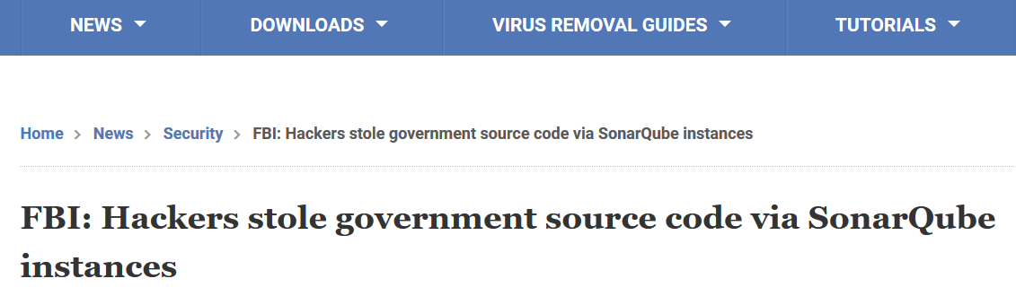
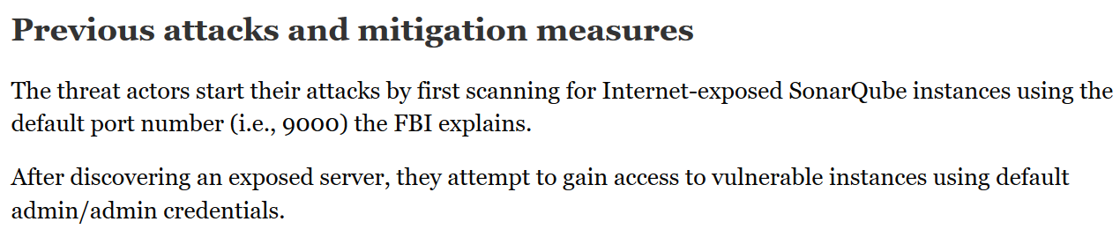
Security misconfiguration - example

Slide 37
Security misconfiguration - solutions
A repeatable hardening process that makes it fast and easy to deploy another environment that is properly locked down.
A minimal platform without any unnecesary features, components, documentation, and samples.
A task to review and update the configurations appropiate to all security notes, updates and patches as part of the patch management process.
A segmented application architecture that provides effective, secure separation between components or tenants, with segmentation, containerization, or cloud security groups.

Slide 38
Injection
Broken Authentication
Insecure Deserialization
Using components with vulnerabilities
Insufficient Logging
Cross Site Scripting
Security Misconfiguration
Sensitive data exposure
Broken Access Control
XML External Entity
OWASP TOP 10

Slide 39
Cross site scripting
XSS flaws occur whenever an application includes untrusted data in a web page without proper validation or escaping, or updates an existing web page with-user supplied data using a browser API that can create HTML or Javascript. XSS allow attackers to execute scripts in the victim’s browser which can hijack user sessions, deface web sites, or redirect the user to malicious sites.

Slide 40
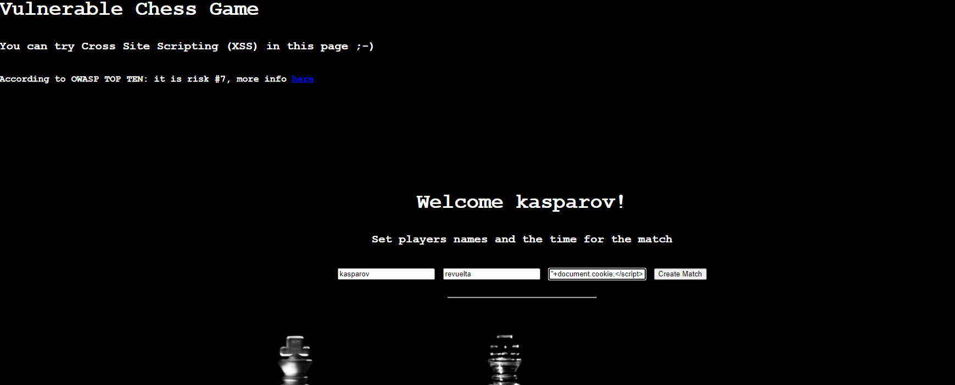
Cross site scripting

Slide 41
Cross site scripting
Using frameworks that automatically escape XSS by design, such as the latest Ruby on Rails, React JS.
Escaping untrusted HTTP request data based on the in the HMTL output.
Validate all inputs.
To enable XSP you need to configure your web server to return the Content-Security-Policy HTTP header.
Enable a Content Security Policy (CSP) as a defense-in-depth mitigating control against XSS.
CSP makes it possible for server administrator to reduce or eliminate the vectors by which XSS can occur by specifying the domains that the browser should consider to be valid sources of executable scripts.

Slide 42
Injection
Broken Authentication
Insecure Deserialization
Using components with vulnerabilities
Insufficient Logging
Cross Site Scripting
Security Misconfiguration
Sensitive data exposure
Broken Access Control
XML External Entity
OWASP TOP 10

Slide 43
Insecure deserialization - definition
Insecure deserialization often leads to remote code execution. Even if deserialization flaws do not result in remote code execution, they can be used to perform attacks, including replay attacks, injection attacks, and privilege escalation attacks.
Front End
Business Logic
bbdd
attacker
Object serialized
Object modified

Slide 44
Insecure deserialization - solution
Implementing integrity checks such as digital signatures on any serialized objects to prevent hostile object creation or data tampering.
Isolating and running code that deserializes in low privilege environments when possible.
Restricting or monitoring incoming and outgoing network connectivity from containers or servers that deserialize.
Monitoring deserialization, alerting if a user deserializes constantly.

Slide 45
Injection
Broken Authentication
Insecure Deserialization
Using components with vulnerabilities
Insufficient Logging
Cross Site Scripting
Security Misconfiguration
Sensitive data exposure
Broken Access Control
XML External Entity
OWASP TOP 10

Slide 46

Using components with vulnerabilities - definition
Components, such as libraries, frameworks, and other software modules, run with the same privileges as the application. If a vulnerable component is exploited, such an attack can facilitate serious data loss or server takeover. Applications and APIs using components with known vulnerabilities may undermine application defenses and enable various attacks and impacts.
Own source code
Open source components

Slide 47
Using components with vulnerabilities – example 1
pip install package-name
Typosquatting attack
pip install reqeusts
pip install coffe-script

Slide 48
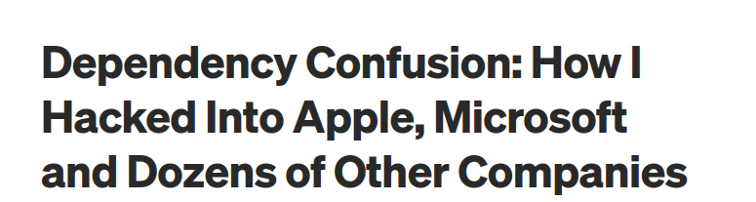

Using components with vulnerabilities – example 2

Slide 49
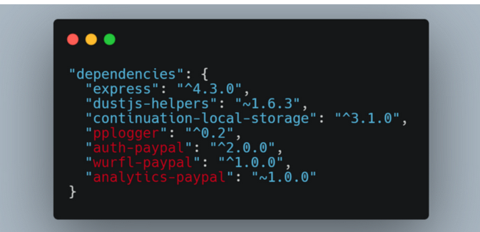
Using components with vulnerabilities – example 2

Slide 50
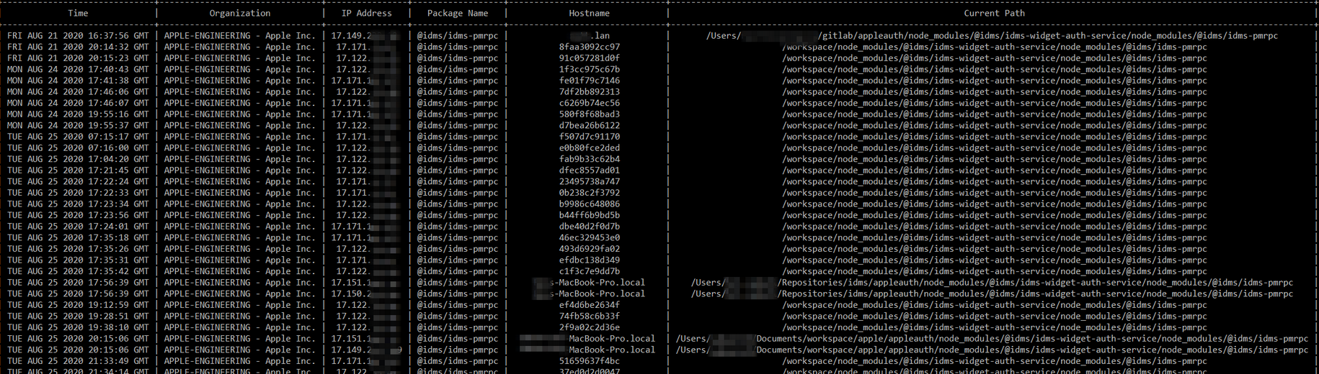
Using components with vulnerabilities – example 2

Slide 51
Using components with vulnerabilities – solutions
Remove unused dependencies, unnecesary features, components, files and documentation.
Continuously inventory the versions of both client-side and server-side components (frameworks and libraries) and their dependencies and monitor sources like CVE and NVD for vulnerabilities in the components.
Only obtain components from official sources over secure links. Prefer signed packages to reduce the chance of including a modified, malicious component.

Slide 52
Injection
Broken Authentication
Insecure Deserialization
Using components with vulnerabilities
Insufficient Logging
Cross Site Scripting
Security Misconfiguration
Sensitive data exposure
Broken Access Control
XML External Entity
OWASP TOP 10

Slide 53

Insufficient Logging and Monitoring - definition
Insufficient Logging and Monitoring, coupled with missing or ineffective integration with incident response, allows attackers to further attack systems, maintain persistence, pivot to more systems, and tamper, extract, or destroy data.
Most breach studies show time to detect a breach is over 200 days, typically detected by external parties rather than internal processes or monitoring.

Slide 54
Insufficient Logging and Monitoring - solutions
Ensure all login, access control failures, and server-side input validation failures can be logged with sufficient user context to identify suspicious or malicious accounts, and held for sufficient time to allow delayed forensic analysis.
Ensure that logs are generated in a format that can be easily consumed by a centralized log management solutions.
Ensure high-value transactions have an audit trail with integrity controls to prevent tampering or deletion, such as append-only database tables or similar.

Slide 55
Owasp and secure software life cycle
Requirement
Design
Build
Development
Operate
Deploy
Release
Tests
Security requirements

Slide 56
Owasp and secure software life cycle
Requirement
Design
Build
Development
Operate
Deploy
Release
Tests
Threat Modeling
Security requirements

Slide 57
Owasp and secure software life cycle
Requirement
Design
Build
Development
Operate
Deploy
Release
Tests
Threat Modeling
Security requirements
SAST tools

Slide 58
Owasp and secure software life cycle
Requirement
Design
Build
Development
Operate
Deploy
Release
Tests
Threat Modeling
SCA tools
Security requirements
SAST tools

Slide 59
Owasp and secure software life cycle
Requirement
Design
Build
Development
Operate
Deploy
Release
Tests
Threat Modeling
SCA tools
IAST
DAST
tools
Security requirements
SAST tools

Slide 60
Owasp and secure software life cycle
Container
tools
Requirement
Design
Build
Development
Operate
Deploy
Release
Tests
Threat Modeling
SCA tools
IAST
DAST
tools
Security requirements
SAST tools

Slide 61
Owasp and secure software life cycle
Container
tools
Requirement
Design
Build
Development
Operate
Deploy
Release
Tests
Threat Modeling
SCA tools
Cloud tools
IAST
DAST
tools
Security requirements
SAST tools

Slide 62
Owasp and secure software life cycle
Container
tools
Requirement
Design
Build
Development
Operate
Deploy
Release
Tests
Threat Modeling
SCA tools
Cloud tools
IAST
DAST
tools
Security requirements
SAST tools
Malware tools

Slide 63
Thanks ++
sebastianrevuelta@gmail.com
https://www.linkedin.com/in/sebasrevuelta/

